Slide 1

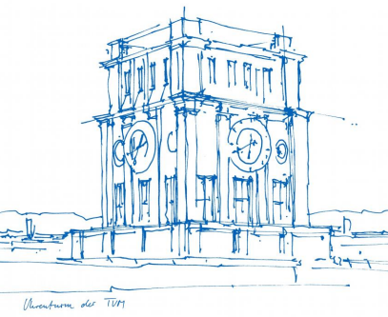
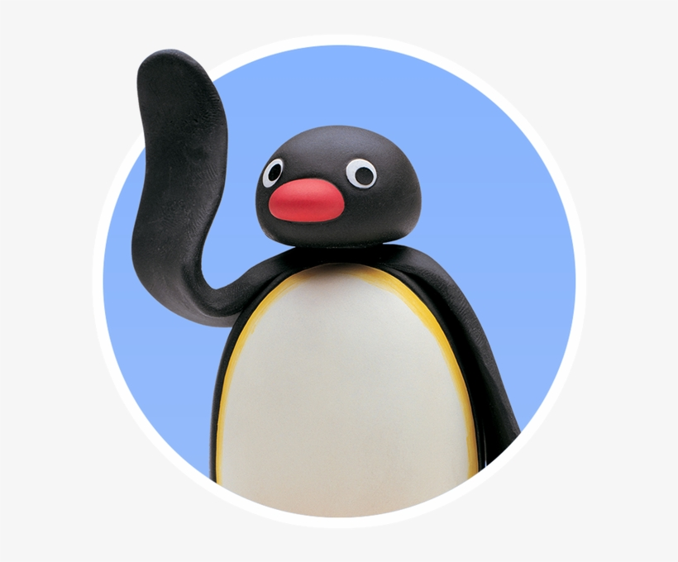
Interaction Prototyping
Lehrstuhl für Ergonomie TUM School of Engineering and Design Technical University of Munich
Milestone 4
The Rolling Penguins
Vincent Brunner Beatrice Seibert Stefano Ferrari
Winter Semester 2021/2022

Slide 2
Lehrstuhl für Ergonomie TUM School of Engineering and Design Technical University of Munich
Content
Decision Process/Reflections
Test design - Quantitative Evaluation
Backend
Frontend

Slide 3

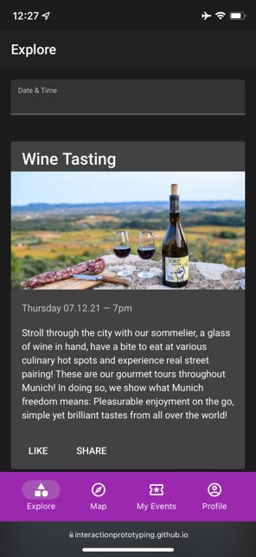

Lehrstuhl für Ergonomie TUM School of Engineering and Design Technical University of Munich
1. Decision Process/ Reflections
Third Milestone
Fourth Milestone
Well developed structure
"Wizard of Oz" prototype
Positive points already included
Negative points to be improved:
Search structure
Event card details
Google maps
Restructuring of profile

Slide 4
Lehrstuhl für Ergonomie TUM School of Engineering and Design Technical University of Munich
2. Test design Quantitative Evaluation
Test Definitions
Communication with User
Test Scope
Validate hypothesis
Testing Proce-dure
Equip-ment
for User and Interviewer
2 parts
Test Design
Within-subject testing
Intro- duction
Ask for recording allowance
Test Scenario / Context
Pre-Task
Provide Dummy Account for registration
Support user by installation App to Smartphone
Test Task + Questionnaires
Give instruction to user

Slide 5
Lehrstuhl für Ergonomie TUM School of Engineering and Design Technical University of Munich
2. Research Question and Hypothesis
Part 1: User Tasks
Part 2: Questionnaires
Does the user understand how to save and share events?
How does our protoype perform in User Experience?
Does the user understand how to search for events?
Users can save events within the details view of an event. The user does not make more than 2 errors.
Users do not find the CTA for sharing an event. It takes the user more than 10 seconds to see this feature.
As our Event Finder app should make fun to use to our target user group, we are assuming our user do evaluate our app in regards of Usability and UX as min “good” on the UEQ rating scale for web services.
Users have two options to search for events. We are assuming the user will find a high usability measuring the SUS Score with 70+ for web services.

Slide 6
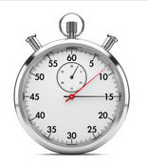

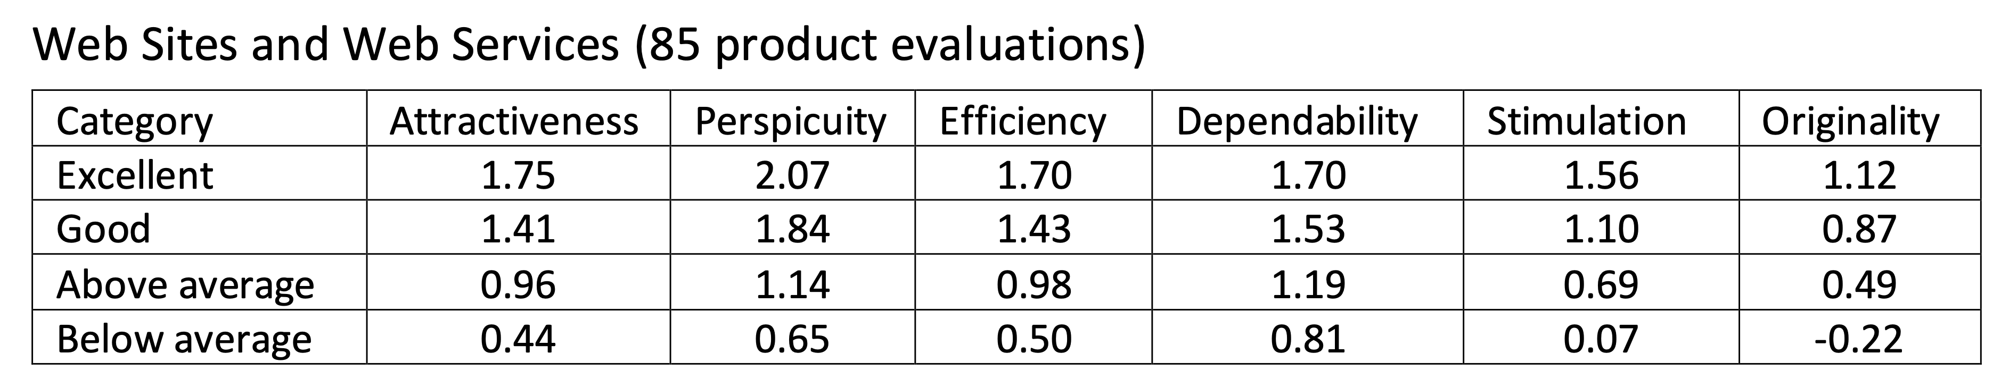
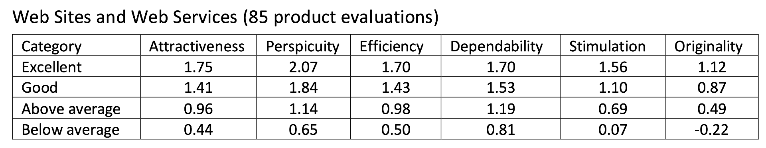
Lehrstuhl für Ergonomie TUM School of Engineering and Design Technical University of Munich
2. Metrics
Part 1: User Tasks
Part 2: Questionnaires
Count the numbers of errors for given task
Count the time for given task completion
System Usability Scale (Brooke 1996, Bangor 2009)
User Experience Questionnaire (Laugwitz et al. 2008) rating scale for web services
Source: https://pixabay.com

Slide 7
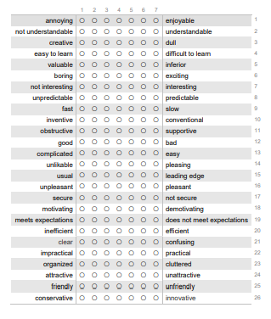
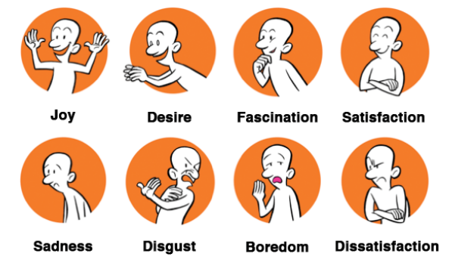
Lehrstuhl für Ergonomie TUM School of Engineering and Design Technical University of Munich
2. Testdesign – Quantitative Evaluation
Part 2: Quantitative (UEQ) vs Qualitative (LEMtool)
Pure qualitatively based on the user's opinion on the interface
Validated questionnaire

Slide 8
Lehrstuhl für Ergonomie TUM School of Engineering and Design Technical University of Munich
2. Testdesign – Quantitative Evaluation
Part 2: Quantitative (UEQ) vs Qualitative (LEMtool)
Pure qualitatively based on the user's opinion on the interface
Validated questionnaire

Slide 9





Lehrstuhl für Ergonomie TUM School of Engineering and Design Technical University of Munich
3. Backend
( )

Slide 10
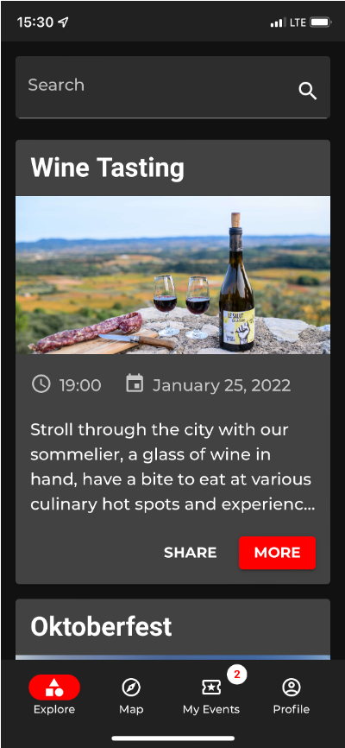
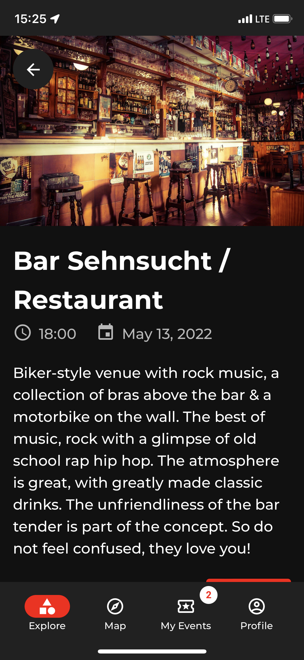
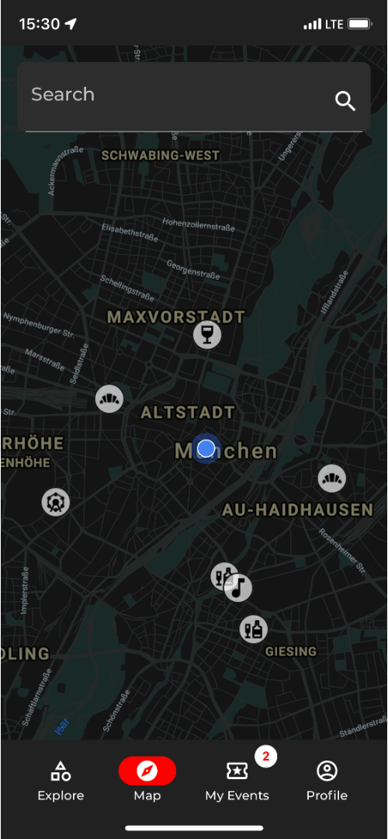
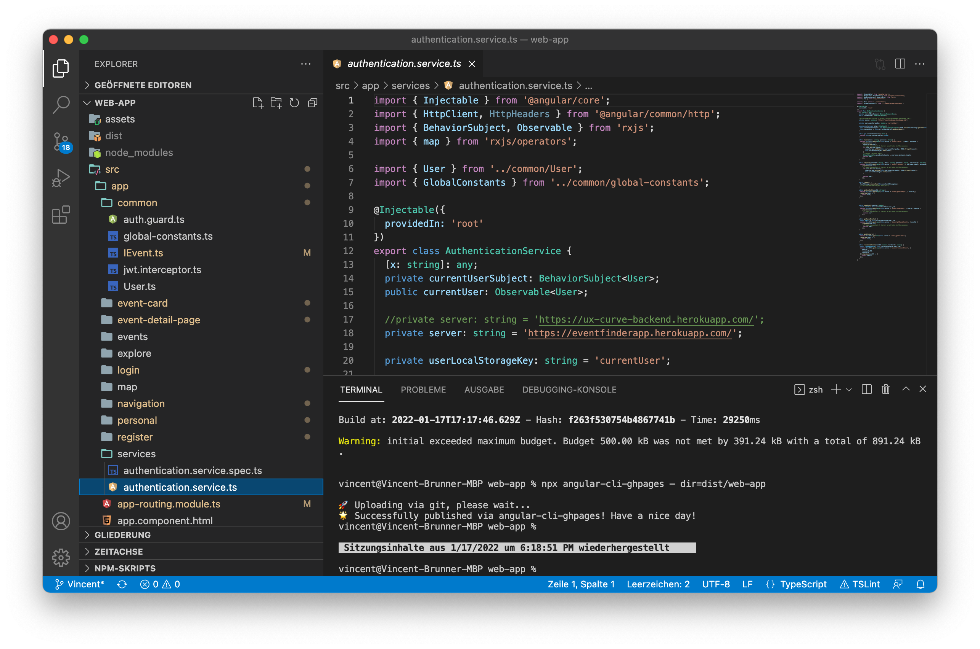
Lehrstuhl für Ergonomie TUM School of Engineering and Design Technical University of Munich
3. Frontend
https://interactionprototyping.github.io/ WS2022_RollingPenguins/login

Slide 11
Lehrstuhl für Ergonomie TUM School of Engineering and Design Technical University of Munich
Literature
Laugwitz, B., T. Held And M. Schrepp (2008). Construction and evaluation of a user experience questionnaire. In Symposium of the Austrian HCI and usability engineering group. Springer, p. 63-76.
Brooke, J. (1996). SUS: A ‘quick and dirty’ usability scale. In Jordan, P.; Thomas, B.; Weerdmeester, B. & McClelland, I. L. (ed.) Usability Evaluation in Industry. p. 189-194.
Bangor, A., Kortum, P. T. und Miller, J. T. (2008). An Empirical Evaluation of the System Usability Scale, International Journal of Human-Computer Interaction, 24 (6), p. 574 – 594.
Huisman, G., Van Hout, M., Van der Geest, T., Heylen, D., LEMtool – Measuring Emotions in Visual Interfaces (2013), p.353.
Bangor, A., PhD, Kortum, P., PhD & Miller, J., PhD. (2009, 1. April). Determining What Individual SUS Scores Mean: Adding an Adjective Rating ScaleJUS. Accessed on 19. January 2022, from https://uxpajournal.org/de/determining-what-individual-sus-scores-mean-adding-an-adjective-rating-scale/

Slide 12

Lehrstuhl für Ergonomie TUM School of Engineering and Design Technical University of Munich
Thank you for your attention!
… any questions?

Slide 13
Lehrstuhl für Ergonomie TUM School of Engineering and Design Technical University of Munich
Back Up

Slide 14
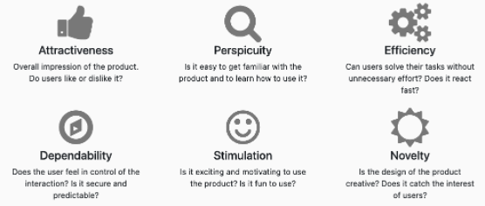
Lehrstuhl für Ergonomie TUM School of Engineering and Design Technical University of Munich
UEQ

Slide 15
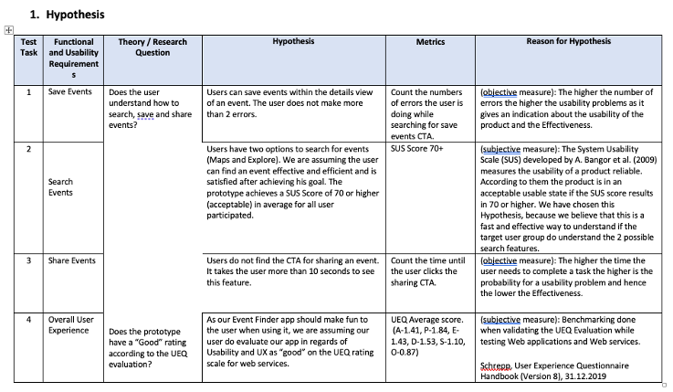
Lehrstuhl für Ergonomie TUM School of Engineering and Design Technical University of Munich
Hypothesis

Slide 16
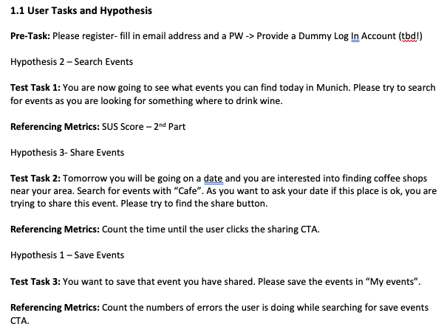
Lehrstuhl für Ergonomie TUM School of Engineering and Design Technical University of Munich
User Tasks

Slide 17
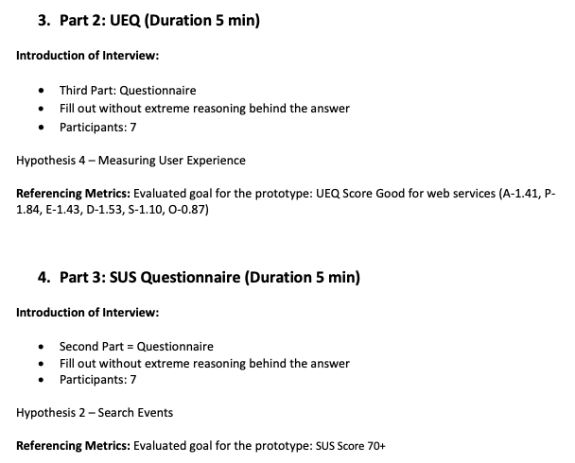
Lehrstuhl für Ergonomie TUM School of Engineering and Design Technical University of Munich
User Tasks

